Slide 1

SAI VIDYA INSTITUTE OF TECHNOLOGY
Department of Computer Science and Engineering
Rajanukunte, Bengaluru - 560064
Traffic rule violation detection and reporting system
By
Rakesh M R 1VA17CS040
B G Vinayak 1VA17CS010
Under the guidance of
Prof. Santhosh Reddy P
Assistant Professor
Dept. of CSE

Slide 2
Presentation Outline
Introduction
Problem Statement
Existing System
Proposed System
Methodology
Applications
Conclusion
References
Dept. of CSE, SVIT ‹#›

Slide 3
Introduction
The increasing number of cars in cities can cause high volume of traffic, and implies that traffic violations become more critical nowadays in India and also around the world. This causes severe destruction of property and more accidents that may endanger the lives of the people. To solve the alarming problem and prevent such unfathomable consequences, traffic violation detection systems are needed. For which the system enforces proper traffic regulations at all times, and apprehends those who do not comply.
A traffic violation detection system must be realized in real-time as the authorities track the roads all the time. Hence, traffic enforcers will not only be at ease in implementing safe roads accurately, but also efficiently; as the traffic detection system detects violations faster than humans. A user friendly graphical interface is associated with the system to make it simple for the user to operate the system, monitor traffic and take action against the violations of traffic rules.
Dept. of CSE, SVIT ‹#›

Slide 4
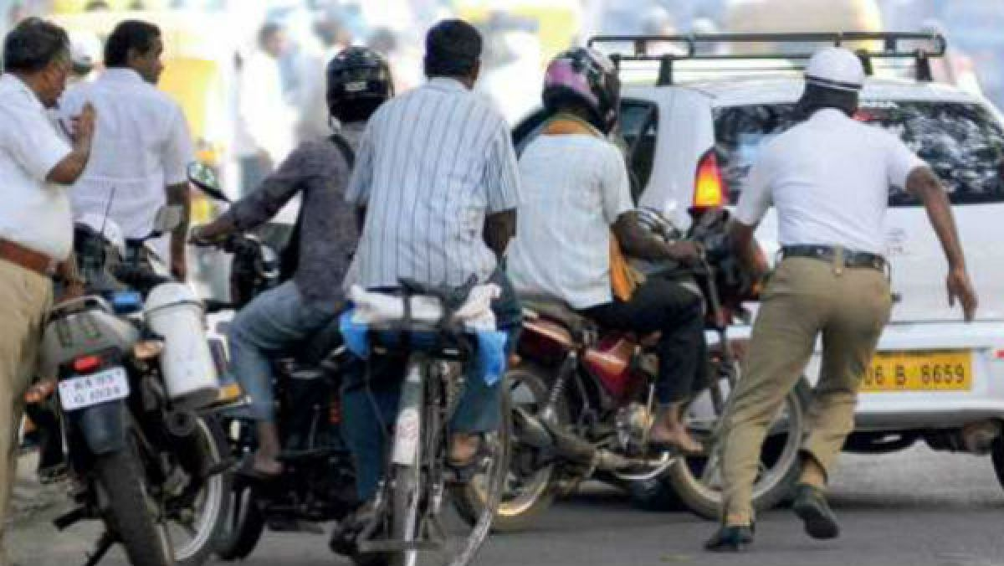
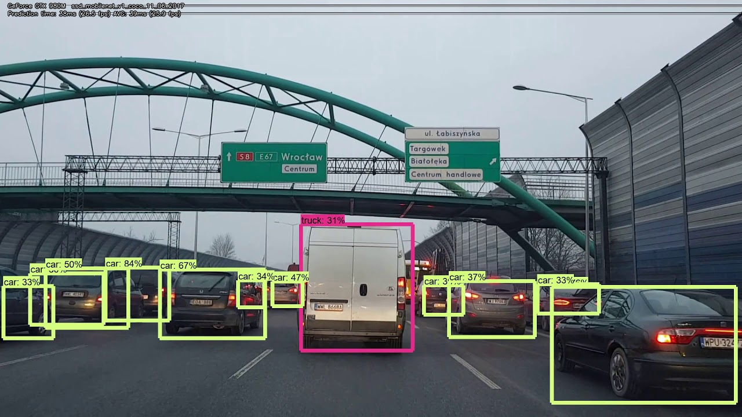
Problem Statement
To develop an efficient and accurate solution for automating the detection of violation of traffic rules and reporting the victim in a minimal amount of time.
Dept. of CSE, SVIT ‹#›

Slide 5
Existing System
Existing system of manual booking of traffic violation cases consumes lot of time and energy.
As enormous time is required for manually challaning the traffic violators, Traffic Police officers do not give adequate time for traffic regulation and clearing traffic jams.
Manual system of booking of traffic violation case is not transparent. It facilitates corrupt practices.
In manual system, there is no record of previous traffic violations by the vehicle. Due to this,repeat offenders escape higher penalties.
There is a scope of pilferage and misappropriation of fine amount collected by Traffic Police. Many times,unscrupulous police officers use duplicate receipt books.
Dept. of CSE, SVIT ‹#›

Slide 6
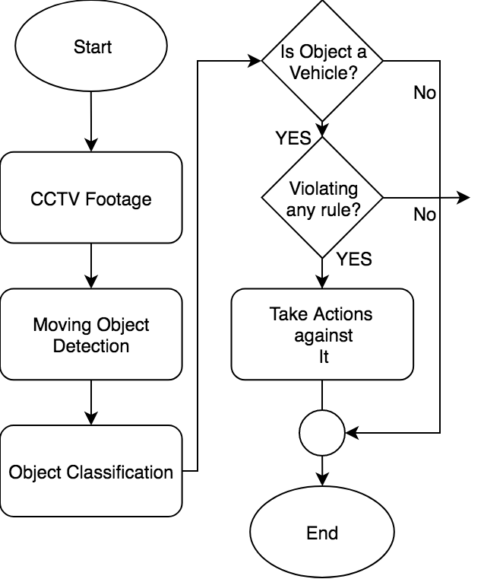
Proposed system
Easy and efficient.
Real time monitoring and reporting.
User friendly.
Easily accessible from anywhere.
Easy to access the vehicle history.
Dept. of CSE, SVIT ‹#›

Slide 7
Methodology
The project is based on Machine Learning and is implemented using python.
OpenCV (Open Source Computer Vision Library) is an open source computer vision and machine learning software library.
Dept. of CSE, SVIT ‹#›

Slide 8
Applications
Will reduce processing and disposal time of traffic violations
Will bring transparency in enforcement of traffic laws and rules
Will help in bringing more safety on roads
Will result in reduction of rash and negligent driving
Will avoids conflicts between police and public
Dept. of CSE, SVIT ‹#›

Slide 9
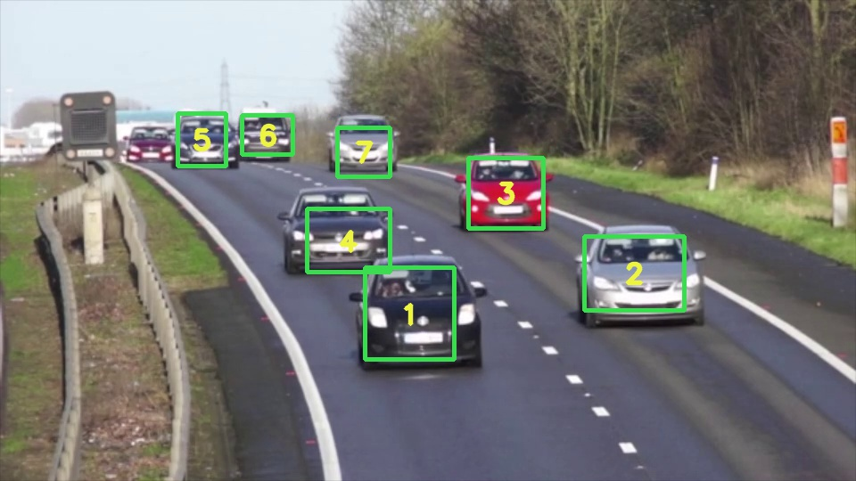
Conclusion
The Traffic Monitoring System is one of the effective tools for enforcement of traffic rules on Indian roads in a transparent manner. The system aims at harnessing strength of technology and minimise human intervention to bring about the speed and transparency in the whole process of traffic regulation.
Dept. of CSE, SVIT ‹#›

Slide 10
References
en.wikipedia.org/wiki/Traffic
Ministry of Home Affairs,Govt. of India
https://ieeexplore.ieee.org/document/8343528
http://www.jetir.org/papers/JETIR1703020.pdf
Dept. of CSE, SVIT ‹#›

